Slide 1

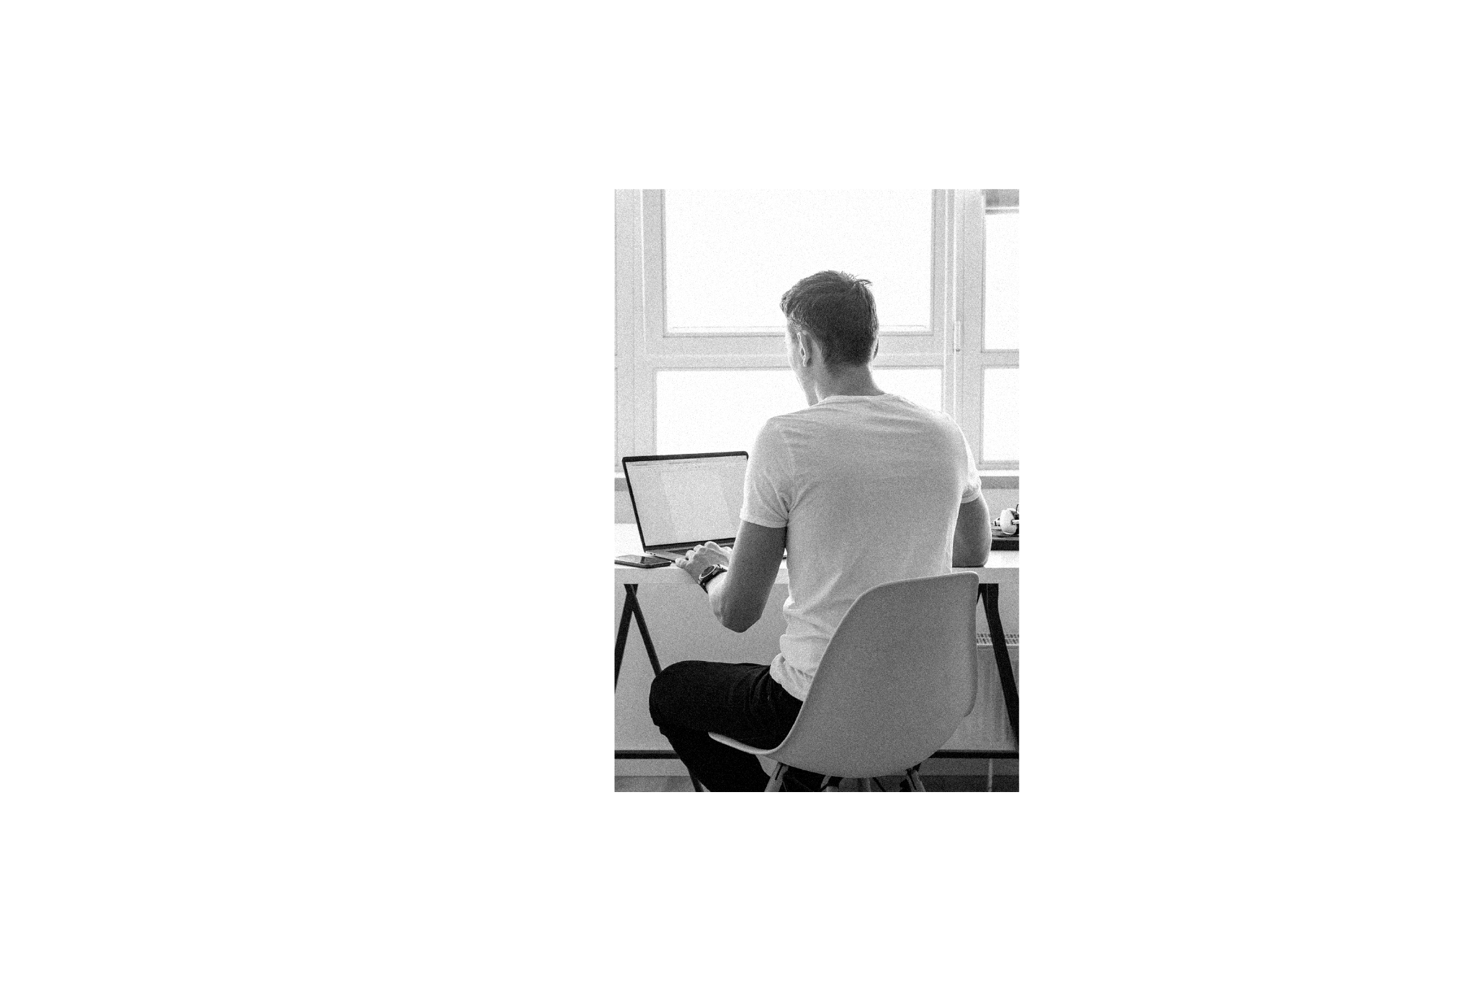

EDUWORK
Free Class Web Programming
www.eduwork.id

Slide 2
BOOTSTRAP
Present by Eduwork.id
www.eduwork.id

Slide 3



www.eduwork.id | Page 01
Bootstrap
Apa itu Bootstrap ?
Bootstrap adalah framework open-source khusus front end yang awalnya dibuat oleh Mark Otto dan Jacob Thornton untuk mempermudah dan mempercepat pengembangan web di front end.
https://getbootstrap.com/

Slide 4
www.eduwork.id | Page 01
CDN BOOTSTRAP
<!-- CSS only -->
<link href="https://cdn.jsdelivr.net/npm/bootstrap@5.1.3/dist/css/bootstrap.min.css" rel="stylesheet" integrity="sha384-1BmE4kWBq78iYhFldvKuhfTAU6auU8tT94WrHftjDbrCEXSU1oBoqyl2QvZ6jIW3" crossorigin="anonymous">
<!-- JavaScript Bundle with Popper -->
<script src="https://cdn.jsdelivr.net/npm/bootstrap@5.1.3/dist/js/bootstrap.bundle.min.js" integrity="sha384-ka7Sk0Gln4gmtz2MlQnikT1wXgYsOg+OMhuP+IlRH9sENBO0LRn5q+8nbTov4+1p" crossorigin="anonymous"></script>

Slide 5
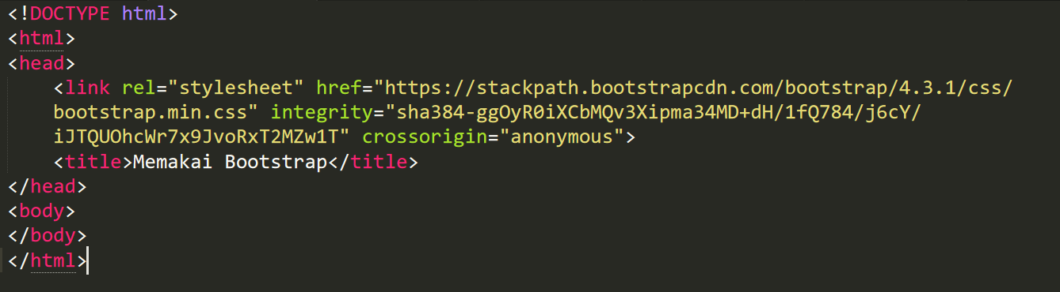
www.eduwork.id | Page 01
CDN BOOTSTRAP

Slide 6
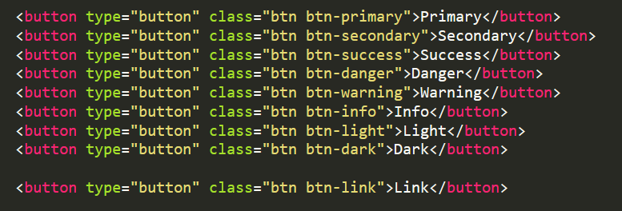
www.eduwork.id | Page 01
Button

Slide 7
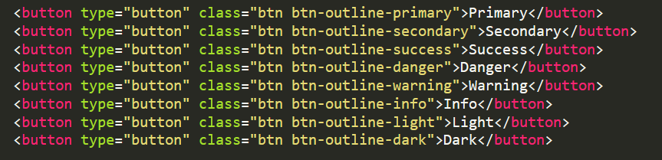
www.eduwork.id | Page 01
Outline Button

Slide 8
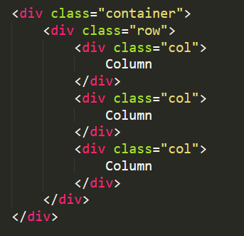
www.eduwork.id | Page 01
Column

Slide 9
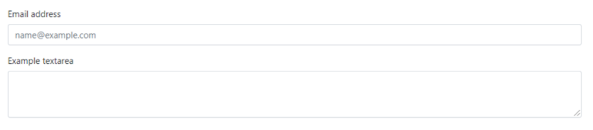
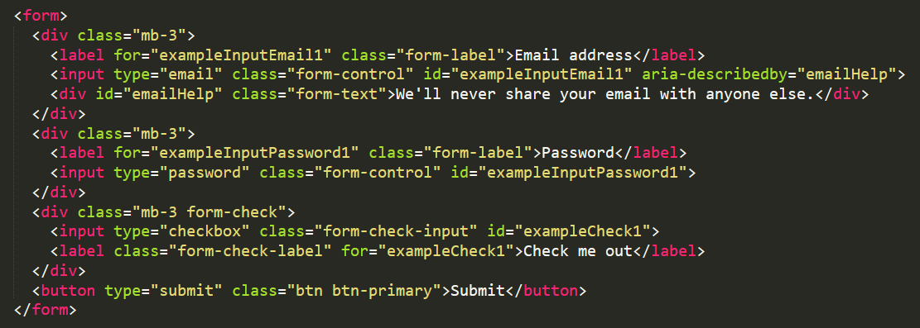
www.eduwork.id | Page 01
Form

Slide 10
www.eduwork.id | Page 01
Referensi Belajar
https://www.youtube.com/watch?v=eow125xV5-c
https://www.youtube.com/watch?v=dtTWD0ystG0
https://www.petanikode.com/bootstrap-dasar

Slide 11
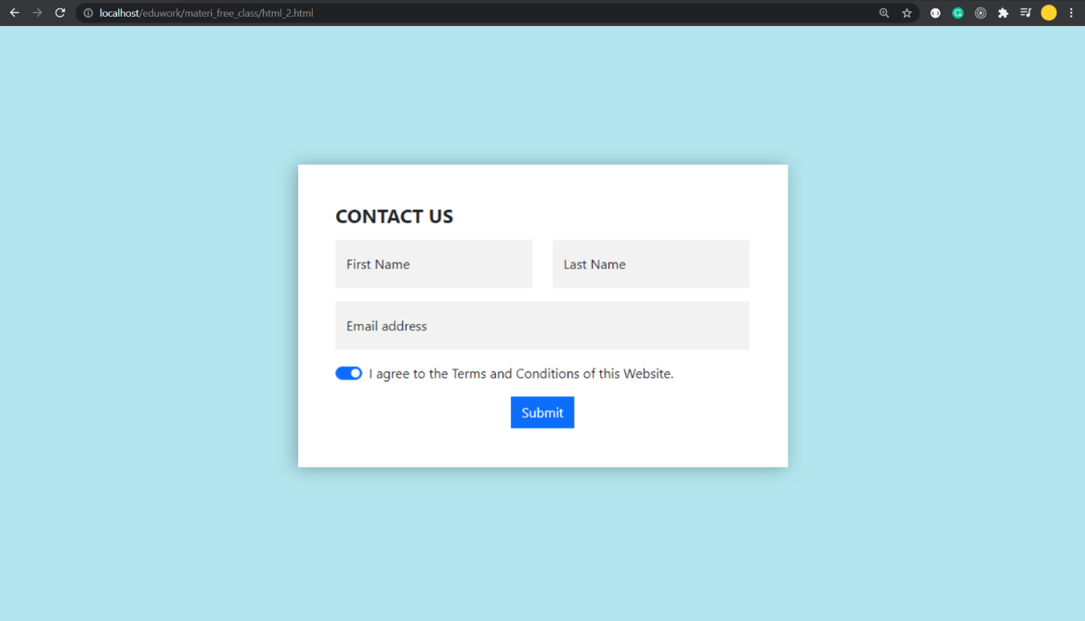
www.eduwork.id | Page 01
Latihan Studi Kasus (1)

Slide 12
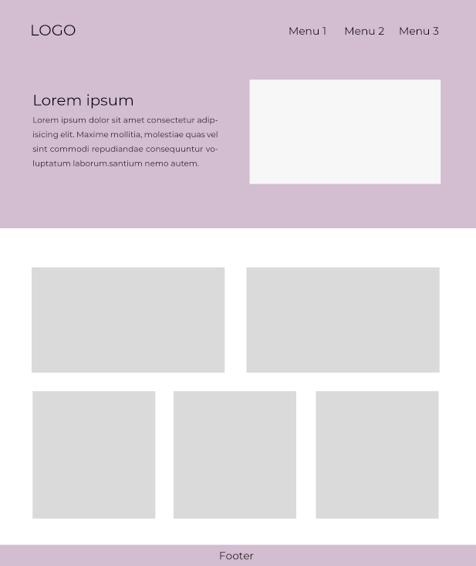
www.eduwork.id | Page 01
Latihan Studi Kasus (2)

Slide 13
TUGAS
Present by Eduwork.id
www.eduwork.id

Slide 14
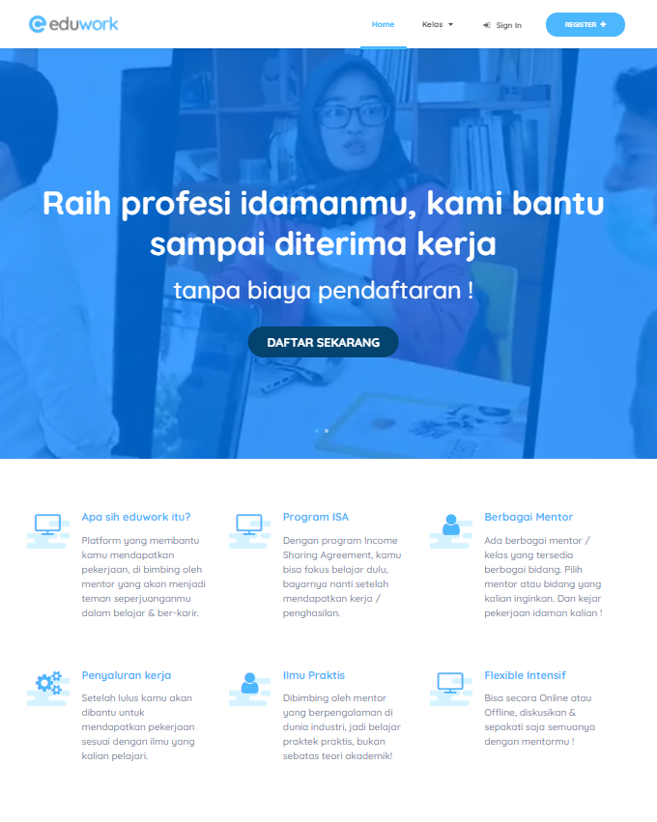
www.eduwork.id | Page 01
Tugas
Buatlah folder tugas_bootstrap di dalam folder freeclass_eduwork
Silahkan buat tampilan seperti tampilan di bawah ini, https://eduwork.id

